Slide 1
Chapter 7
Ensemble learning
Voting
Bootstrap aggregation (bagging)
Adaboost

Slide 2
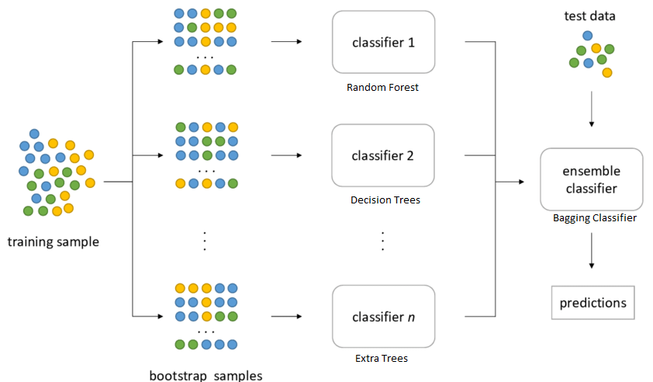
Ensemble learning
Group of
weakly classifier
Voting

Slide 3
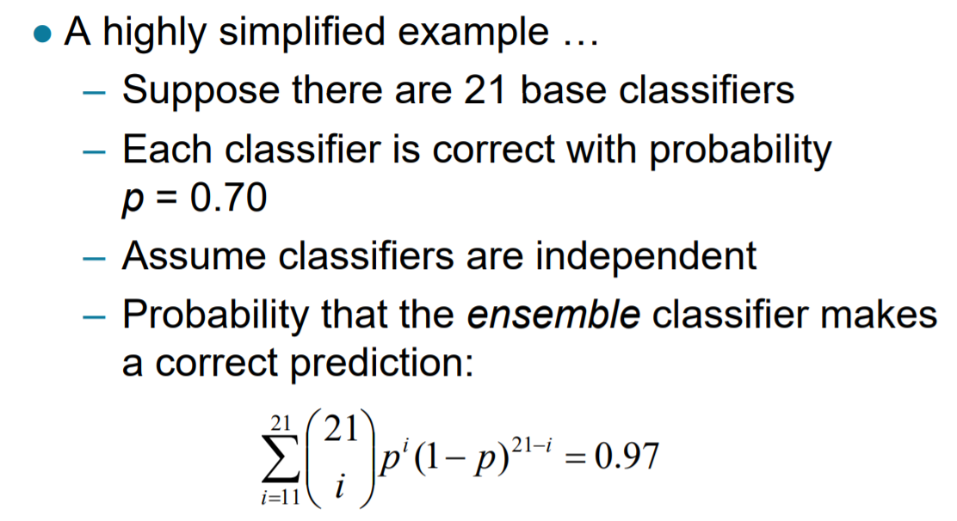
Why do ensembles work?
Binomial distribution

Slide 4
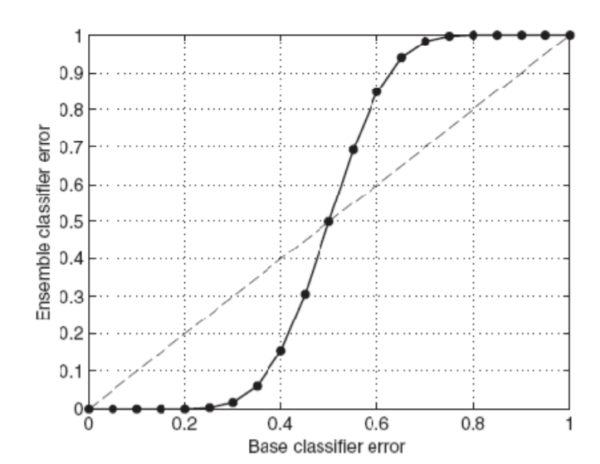
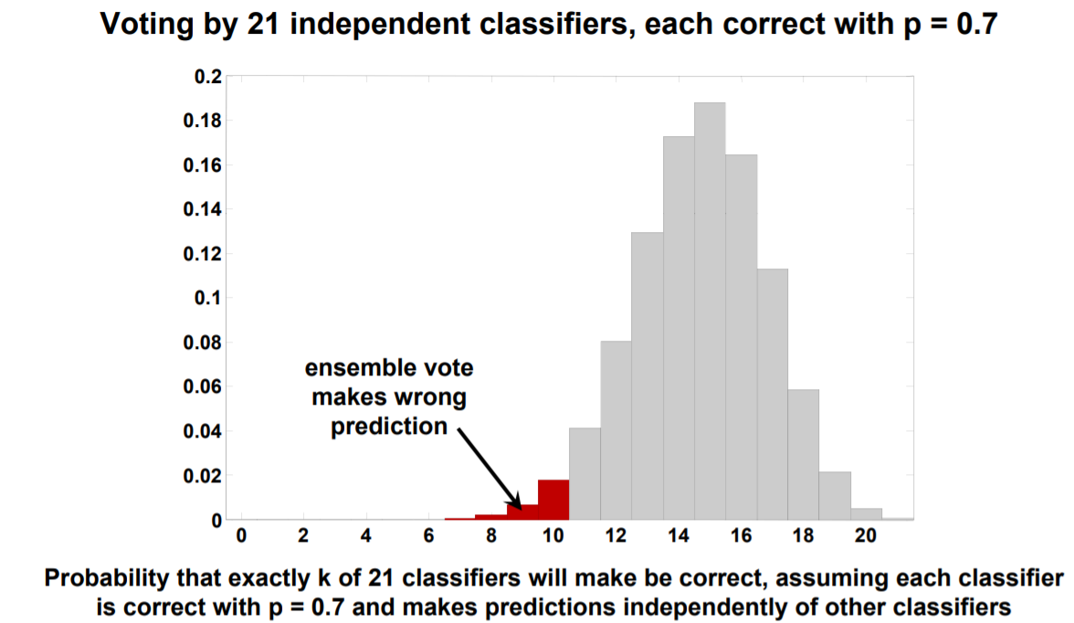
Why do ensembles work?

Slide 5
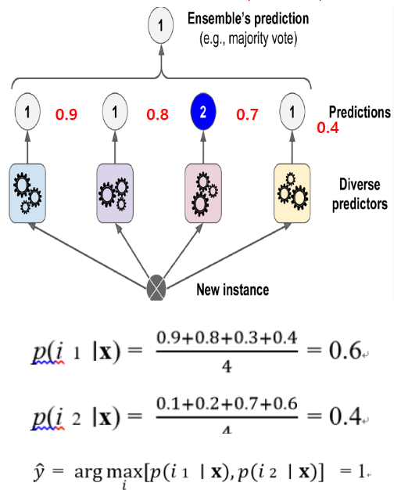
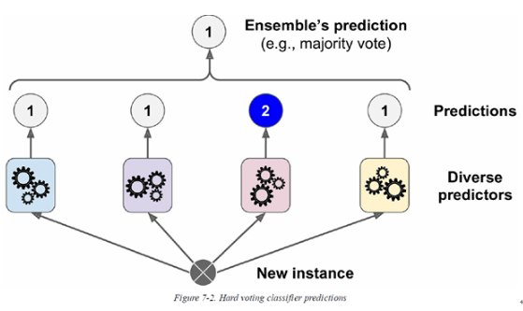
Voting
Hard voting (plurality voting)
Soft voting

Slide 6
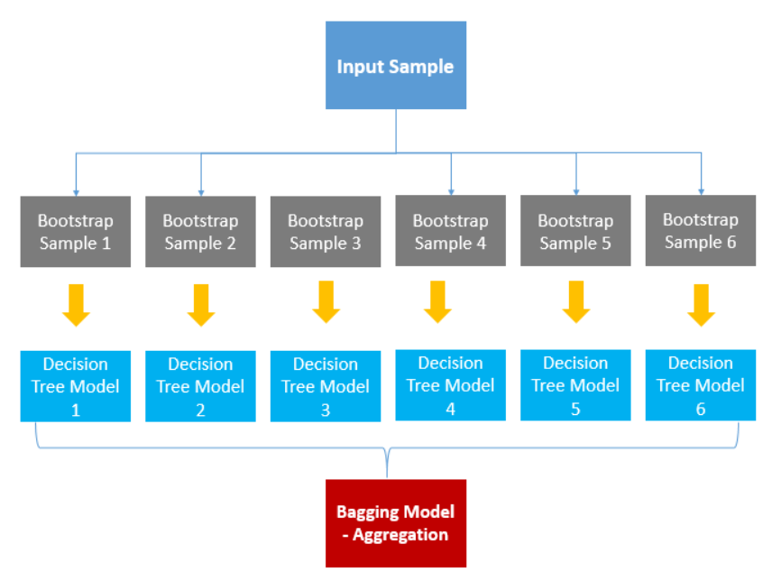
Bootstrap aggregation
Example) voting

Slide 7
Ensemble learning application: Adaboost

Slide 8
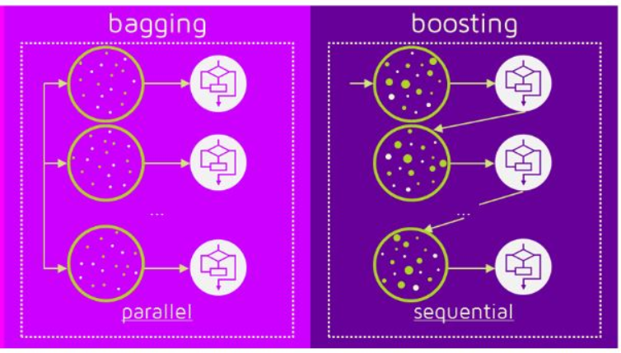
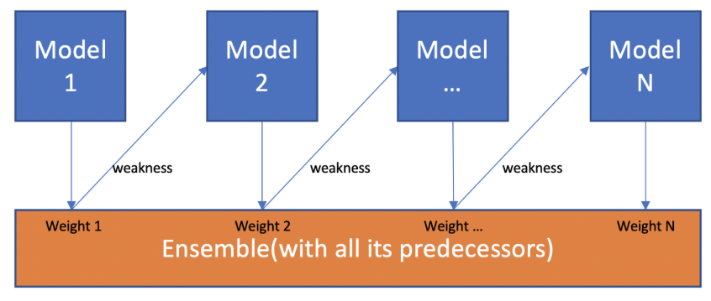
Ensemble learning: boosting

Slide 9
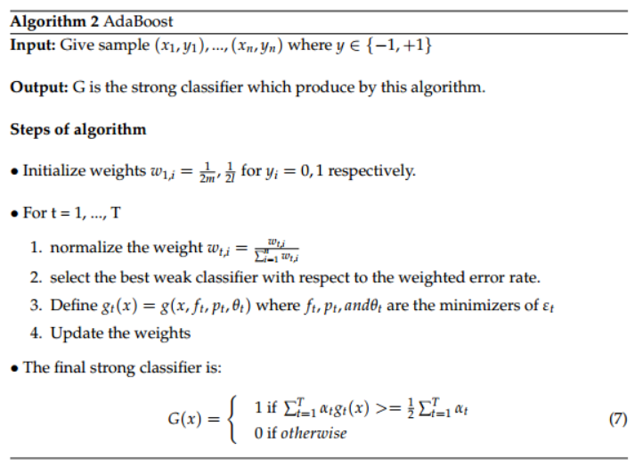
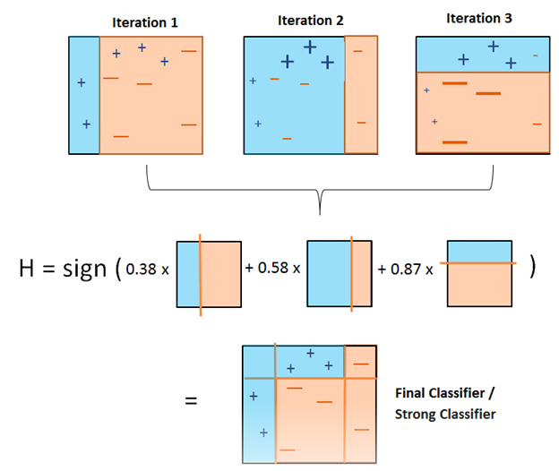
Adaptive boost (Adaboost)

